Slide 1
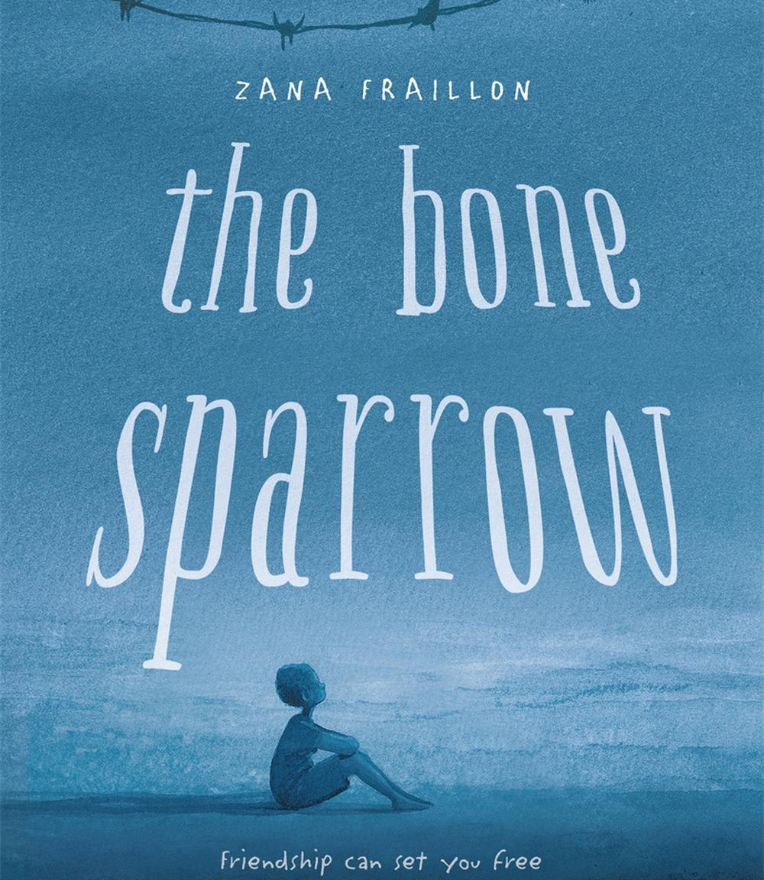
The Bone Sparrow
Starting your text response essay

Slide 2
Learning outcomes
Learning intention
I will be successful when:
To understand the concept of an argument in essay writing
I have written a contention
I have decided on the claims that will support my contention

Slide 3
Entry slip
On your piece of paper, write a short response to the two questions:
What is an argument?
What does the word logic mean to you?

Slide 4
Arguments
An argument isn't just having a verbal disagreement or trying to justify an opinion.
An argument is a type of logic.
An argument is a set of ideas that contains a series of statements (called “claims”) that lead to a conclusion.

Slide 5
An argument is:
A series of statements (called “claims”) that leads to a conclusion.
Take this example:
All lizards are cold blooded.
Frank is my pet goanna.
Goannas are a type of lizard.
Therefore, Frank is cold blooded.

Slide 6
Arguments
* Conclusions often start with the word therefore (which is like the word equivalent of an equal sign).
This has three claims:
All lizards are cold blooded.
Frank is my pet goanna.
Goannas are a type of lizard.
When put together, the three claims lead to a conclusion.
Therefore*, Frank is cold blooded.
If those three claims are true, then the conclusion must be true. There's no way that it can be false.

Slide 7
Arguments
What about this one:
This is a valid argument. It doesn't matter that we don't know what groobs or perfnicks are!
If the claims are true, then there is no way that the conclusion can be false.
All groobs are yellow.
A perfnick is a type of groob.
Therefore, perfnicks must be yellow.

Slide 8
Arguments
All perfnicks are yellow.
A perfnick is a type of groob.
Therefore, all groobs are yellow.
However:
This is not a valid argument.
This conclusion hasn't been proven by the claims (there might be other types of groobs that are different colours).

Slide 9
Arguments
Let’s recap:
An argument has four elements:
A contention – what we think we will prove, or what we hope to prove.
Claims – the statements that we must show that lead to the conclusion.
Evidence – the way that we prove that each claim is true
A conclusion – the main idea that the argument proves.
The only difference between a contention and a conclusion is that a contention occurs at the start, and the conclusion occurs at the end.

Slide 10
Arguments
Try writing your own valid argument!
…
…
Therefore, ....

Slide 11
Apply what you’ve learned
Task 1 – write a contention

Slide 12
Task 1 – Develop a contention
Look at your worksheet from last lesson.
So far, you have:
Chosen one of the three prompts
Unpacked the prompt (found synonyms and antonyms)
Reflection on what the prompt is asking you
Brainstormed ideas.
Your next task is to write a contention and decide on your claims.

Slide 13
Task 1 – Develop a contention
Remember: your contention is what you hope to prove.
But in this case, you also need to respond to the prompt.
That means that your contention must explain an answer to the prompt that you hope to prove.

Slide 14
Task 1 – Develop a contention
The next three slides contain some suggestions for contentions that you can use.
You can either use one of these, or you can develop your own.
Recap:
Q: What is a contention?
A: A contention is a statement that describes what you hope to prove in response to an essay prompt.

Slide 15
Task 1 – Develop a contention
Prompt 1 | Possible contentions This is not a complete list. You might choose to come up with your own!
'But reading is important' (p39). Discuss how stories and imagination are important for characters in The Bone Sparrow. | In The Bone Sparrow, stories and imagination are used as a way to explore characters’ thoughts and personalities. In The Bone Sparrow, stories allow characters to connect with their pasts. For the characters in The Bone Sparrow, stories are a way of keeping the memories of their families alive. In The Bone Sparrow, imagination acts as a distraction that allows characters to survive in a harsh world. What else might you want to explain about the novel and imagination? Why do you think reading is important?

Slide 16
Task 1 – Develop a contention
Prompt 2 | Possible contentions This is not a complete list. You might choose to come up with your own!
'Soon they'll see that living in here isn't living at all. We just need to show them who we are, that we're people, and then they'll remember' (p108) Discuss the living conditions for characters inside and outside the centre. | The Bone Sparrow portrays the harsh reality of life inside Australia's refugee detention system. Zana Fraillon depicts a difference between the way Australians imagine detention and the reality for those living inside. Zana Fraillon's novel illustrates the ways in which Australia does not guarantee the human rights of detained children. The Bone Sparrow helps the audience better understand the feelings of those living in detention. What else could you explain about the living conditions in the novel. What might you say about what it means to be "living", or "showing them who we are."

Slide 17
Task 1 – Develop a contention
Prompt 3 | Possible contentions This is not a complete list. You might choose to come up with your own!
The Bone Sparrow explores themes of family and friendship. Discuss. | The Bone Sparrow shows that friends are just as important as family. The Bone Sparrow shows that friends are a type of family. The Bone Sparrow depicts friends that are more important that family. The Bone Sparrow describes how friends can never take the place of family. Zana Fraillon's novel explores the impact that detention can have on relationships. What else might you want to explain about the way the novel explores family and friendship?

Slide 18
Task 1 – Develop a contention
Your task:
Open the worksheet 4.2w in OneNote
Write out your chosen prompt
Copy or write the contention that you want to use.

Slide 19
Decide on your claims
Task 2

Slide 20
Task 2 – Decide on your claims
Remember:
A claim is a statement that is shown in order to prove your contention. As well as writing your claim, you will also have to prove that it is correct.
Most text response essays written in English class will have three claims.

Slide 21
Task 2 – Decide on your claims
Think back to the film Edward Scissorhands.
Let's say that our contention is that:
Edward Scissorhands is a modern-day fairytale that reminds the audience that beauty is more than skin deep.
The next task would be to think of some claims - statements that would help to prove that this idea is true.

Slide 22
Task 2 – Decide on your claims
We need to try and prove that Edward Scissorhands is a modern-day fairytale about beauty only being skin deep.
Cast your mind back to the film.
What characters, events or ideas can you remember that might relate to:
The film being a modern-day fairytale?
Beauty, and it being more than skin deep?

Slide 23
Task 2 – Decide on your claims
We could make a list of all the possible ideas:
The film is shown as a bedtime story that contains magic and monsters, just like a fairytale.
The story is set in a modern suburb with cars and electricity, where appearances are very important.
There is a strong focus on beauty and ugliness throughout the film.
The main character sells skin-care products, and another runs a hair salon.
The main character is scarred and disfigured, but creates beautiful art.
Ultimately, inner qualities like honesty and empathy are shown to be more important that appearances.

Slide 24
Task 2 – Decide on your claims
Out of all those ideas, which do the best job of working together to support our contention?
Edward Scissorhands is a modern-day fairytale that reminds the audience that beauty is more than skin deep.

Slide 25
Task 2 – Decide on your claims
Edward Scissorhands is a modern-day fairytale that reminds the audience that beauty is more than skin deep.
The film is shown as a bedtime story that contains magic and monsters, just like a fairytale.
The story is set in a modern suburb with cars and electricity, where appearances are very important.
There is a strong focus on beauty and ugliness throughout the film.
The main character sells skin-care products, and another runs a hair salon.
The main character is scarred and disfigured, but creates beautiful art.
Ultimately, inner qualities like honesty and empathy are shown to be more important that appearances.

Slide 26
Task 2 – Decide on your claims
We have now decided on our three claims!
The film is shown as a bedtime story that contains magic and monsters, just like a fairytale.
The main character sells skin-care products, and another runs a hair salon.
The main character is scarred and disfigured, but creates beautiful art.
The other ideas can still be used in our essay though, so don’t delete them!

Slide 27
Task 2 – Decide on your claims
Your task:
Open the worksheet
Brainstorm as many ideas as you can from the novel that relate to your contention.
Choose the best three, and copy them into the spaces for Claim 1, Claim 2 and Claim 3.

